Slide 1



Analyzing the Impact of the LioCinema-Jotstar Merger
LioJotstar
India Ka Apna OTT
Presented by—
Ajay Kumar

Slide 2
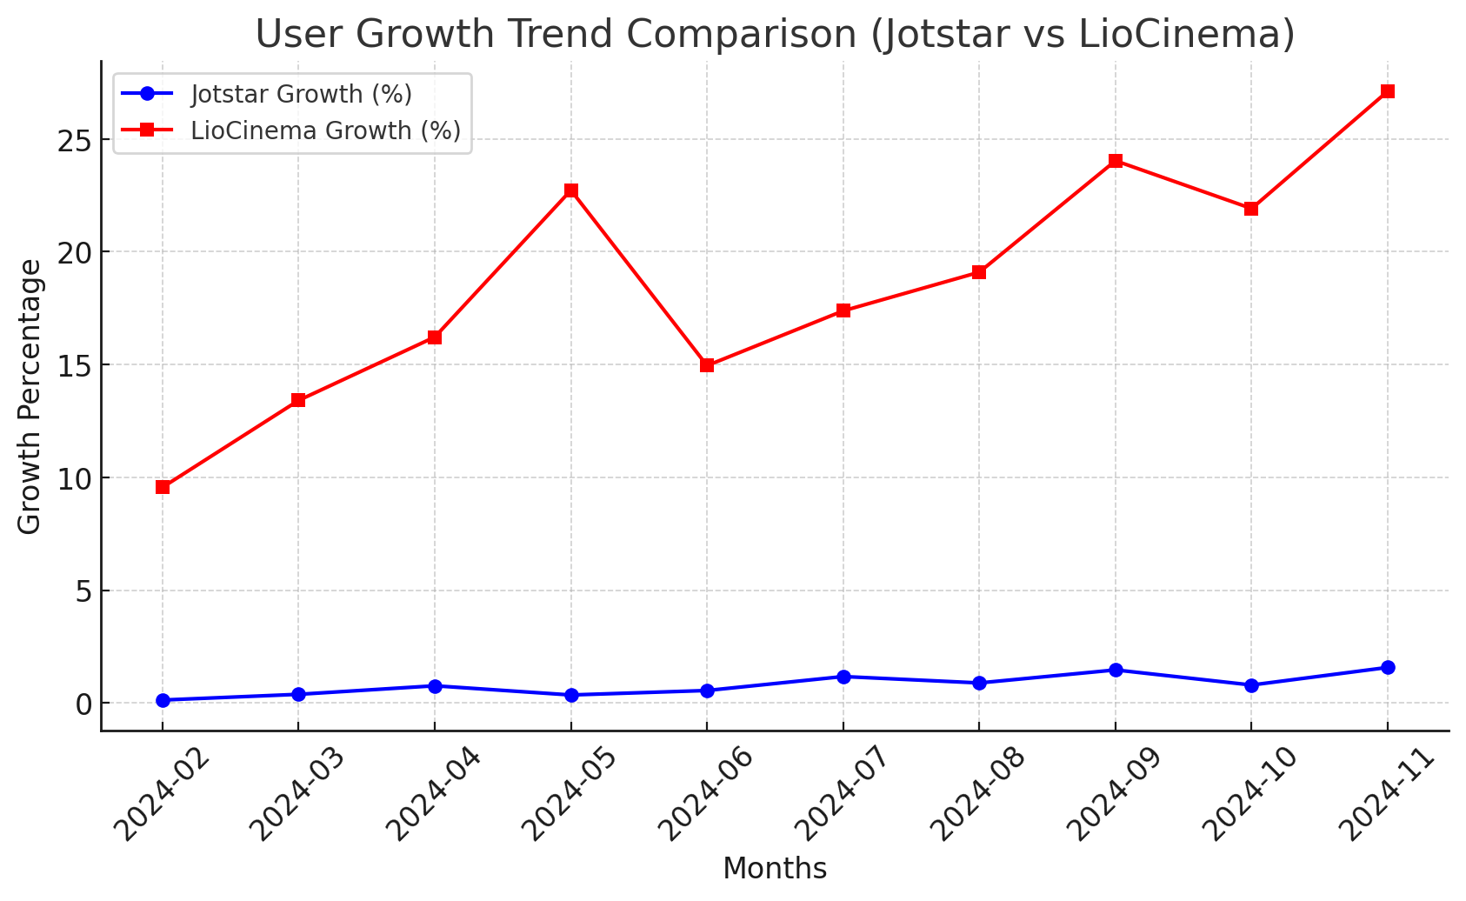
1. Total Users & Growth Trends
What is the total number of users for LioCinema and Jotstar, and how do they compare in terms of growth trends (January–November 2024)?
Month | Jotstar Growth (%) | LioCinema Growth (%)
2024-02 | 0.13% | 9.56%
2024-03 | 0.38% | 13.41%
2024-04 | 0.76% | 16.22%
2024-05 | 0.35% | 22.73%
2024-06 | 0.55% | 14.95%
2024-07 | 1.17% | 17.38%
2024-08 | 0.88% | 19.10%
2024-09 | 1.46% | 24.03%
2024-10 | 0.79% | 21.92%
2024-11 | 1.57% | 27.12%
Total Users as of November 2024
Jotstar: 4,262 users
LioCinema: 36,997 users
Database | Subscribers | Contents | Content Consumption
Jotstar | 44,620 | 2,360 | 133,860
LioCinema | 183,446 | 1,250 | 430,752
Key Insights
Jotstar's growth is slow and steady, with monthly increases below 2%.
LioCinema is experiencing exponential growth, reaching a 27.12% increase in November 2024.

Slide 3
2. Content Library Comparison
What is the total number of contents available on LioCinema vs. Jotstar? How do they differ in terms of language and content type?
Content Library Comparison: LioCinema vs. Jotstar
1. Total Number of Contents
Jotstar: 2037
LioCinema: 1242 ✅ Jotstar has a significantly larger content library than LioCinema.
Language Distribution
Content Type Comparison
Language | Jotstar | LioCinema | Difference
Hindi | 637 | 424 | +213
English | 800 | 56 | +744
Telugu | 203 | 242 | -39
Tamil | 251 | 221 | +30
Kannada | 121 | 118 | +3
Malayalam | 119 | 121 | -2
Marathi | 115 | 68 | +47
Bengali | 60 | 0 | +60
Gujarati | 28 | 0 | +28
Punjabi | 27 | 0 | +27
Content Type | Jotstar | LioCinema | Difference
Movies | 1140 | 898 | +242
Series | 723 | 300 | +423
Sports | 174 | 44 | +130
🔥Key Points
1.Jotstar has nearly twice the content of LioCinema (2037 vs. 1242).
Jotstar dominates in English, Bengali, Gujarati, and Punjabi content.
LioCinema is strong in Telugu content.
Jotstar offers a wider range of Series and Sports content.
📌 For a diverse content experience, Jotstar is the better choice. For Telugu content, LioCinema is preferable. 🚀
✅ Jotstar has more content in English, Bengali, Gujarati, and Punjabi, whereas LioCinema focuses more on Telugu content.

Slide 4
3. User Demographics
What is the distribution of users by age group, city tier, and subscription plan for each platform?
Age Group
City Tier Distributions
Platform | 18-24 | 25-34 | 35-44 | 45+
Jotstar | 7,676 | 20,069 | 11,274 | 5,601
LioCinema | 79,813 | 52,027 | 32,560 | 19,046
Platform | Tier 1 | Tier 2 | Tier 3
Jotstar | 25,451 | 13,424 | 5,745
LioCinema | 41,011 | 63,848 | 78,587
Subscription Plan Distribution
Platform | Free | Basic | VIP | Premium
Jotstar | 12,096 | N/A | 19,157 | 13,367
LioCinema | 104,992 | 53,362 | N/A | 25,092
🔥 Key Points
📌 LioCinema is dominant overall, with a larger user base across all metrics. 📌 Jotstar performs better in Tier 1 cities but struggles in smaller cities. 📌 LioCinema attracts more young users (18-24), while Jotstar is balanced across age groups. 📌 Jotstar’s VIP model is unique, but LioCinema has a much stronger free-tier user base.
✅ Observations:
LioCinema dominates in Tier 2 & Tier 3 cities with 63.8K and 78.5K users, compared to Jotstar's 13.4K and 5.7K, respectively.
Jotstar has a stronger presence in Tier 1 cities (25.4K users) but still lags behind LioCinema (41K).
LioCinema is more popular in smaller cities, while Jotstar has a more urban user base.
✅ Observations:
LioCinema has a massive free-tier user base (104K), compared to Jotstar’s 12K.
Jotstar offers a VIP plan (19K users), which LioCinema doesn’t have.
LioCinema’s paid user base (Basic + Premium = 78K) is higher than Jotstar’s (VIP + Premium = 32.5K).

Slide 5
4. Active vs. Inactive Users
What percentage of LioCinema and Jotstar users are active vs. inactive? How do these rates vary by age group and subscription plan?
Active and Inactive User % by Subscription Plan & Age Group (last 90 days)
LioCinema
Jotstar

Slide 6
Jotstar Active and Inactive Percentage (last 90 days)
Subscription Plan | Age Group | Active Users | Inactive Users | Total Users | Active Percentage | Inactive Percentage
Free | 18-24 | 179 | 399 | 2119 | 8.45 | 18.83
Free | 25-34 | 429 | 1039 | 5458 | 7.86 | 19.04
Free | 35-44 | 206 | 515 | 3011 | 6.84 | 17.1
Free | 45+ | 103 | 243 | 1508 | 6.83 | 16.11
Premium | 18-24 | 43 | 104 | 2305 | 1.87 | 4.51
Premium | 25-34 | 111 | 330 | 5938 | 1.87 | 5.56
Premium | 35-44 | 63 | 148 | 3417 | 1.84 | 4.33
Premium | 45+ | 24 | 78 | 1707 | 1.41 | 4.57
VIP | 18-24 | 141 | 331 | 3252 | 4.34 | 10.18
VIP | 25-34 | 364 | 852 | 8673 | 4.2 | 9.82
VIP | 35-44 | 183 | 471 | 4846 | 3.78 | 9.72
VIP | 45+ | 94 | 202 | 2386 | 3.94 | 8.47
LioCinema Active and Inactive Percentage (last 90 days)
Subscription Plan | Age Group | Active Users | Inactive Users | Total Users | Active Percentage | Inactive Percentage
Basic | 18-24 | 2075 | 6619 | 23172 | 8.95 | 28.56
Basic | 25-34 | 1120 | 3723 | 15112 | 7.41 | 24.64
Basic | 35-44 | 686 | 2143 | 9657 | 7.1 | 22.19
Basic | 45+ | 358 | 1305 | 5421 | 6.6 | 24.07
Free | 18-24 | 6735 | 21616 | 45680 | 14.74 | 47.32
Free | 25-34 | 3925 | 12180 | 30009 | 13.08 | 40.59
Free | 35-44 | 2180 | 7808 | 18458 | 11.81 | 42.3
Free | 45+ | 1221 | 4128 | 10845 | 11.26 | 38.06
Premium | 18-24 | 568 | 1560 | 10961 | 5.18 | 14.23
Premium | 25-34 | 274 | 914 | 6906 | 3.97 | 13.23
Premium | 35-44 | 193 | 546 | 4445 | 4.34 | 12.28
Premium | 45+ | 87 | 341 | 2780 | 3.13 | 12.27

Slide 7
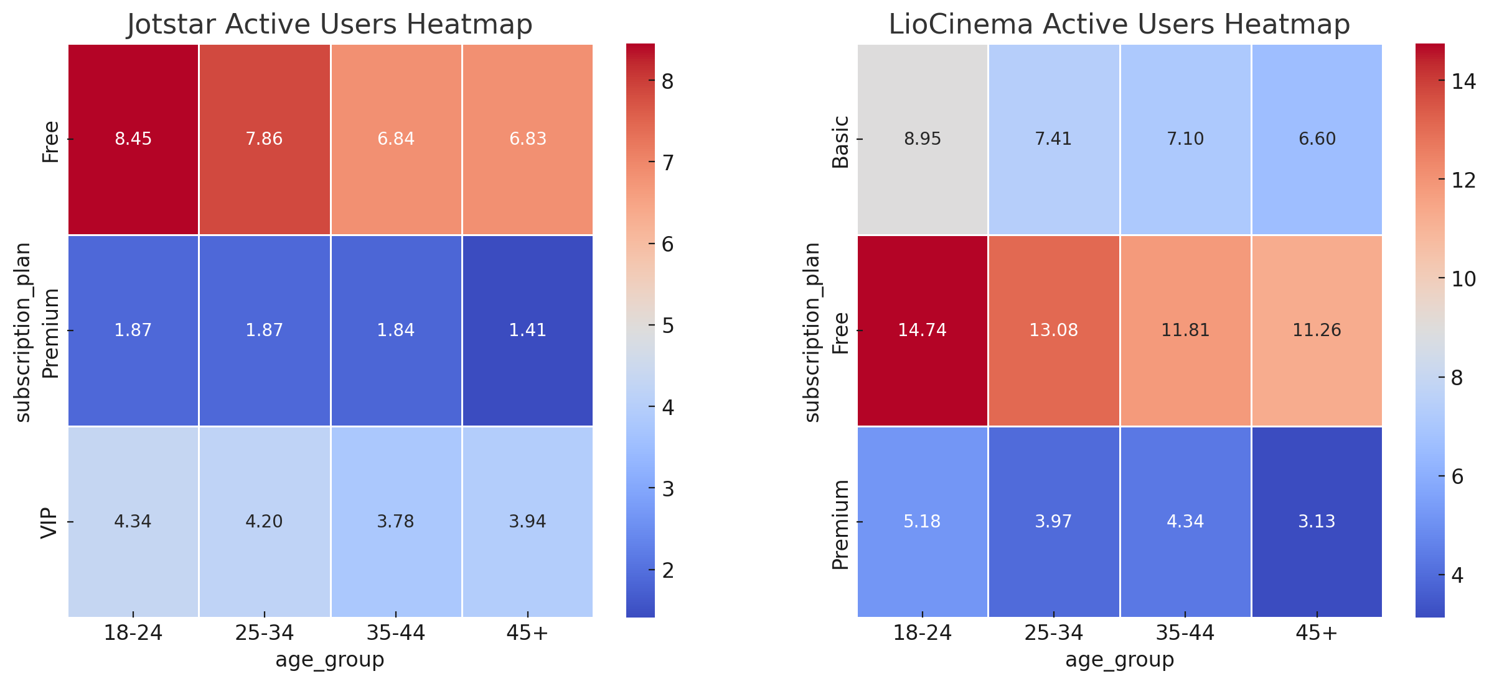
Insights (Last 90 Days)
Jotstar
Free Plan: Younger users (18-24) are the most active (8.45%), but the active percentage declines with age.
Premium Plan: Has the lowest active user engagement, with all age groups below 2%.
VIP Plan: Performs better than Premium but remains under 5%, with engagement highest among 18-24 (4.34%).
LioCinema
Free Plan: Highest engagement among all plans, with 18-24 age group leading at 14.74%.
Basic Plan: Consistently lower active percentage compared to Free, but slightly better than Jotstar's VIP plan.
Premium Plan: Similar to Jotstar, LioCinema's Premium plan has the lowest engagement across all age groups.
Key Takeaways
Free Plans Dominate – Both platforms see the highest engagement from free users, especially in the 18-24 age group.
Premium Plans Underperform – Paid plans struggle with engagement, indicating a need for better incentives.
Younger Users Are More Active – Across both platforms, 18-24 users show the highest activity levels.
Retention Strategies Needed – Premium subscribers need more engagement strategies, such as exclusive content or personalized recommendations.

Slide 8
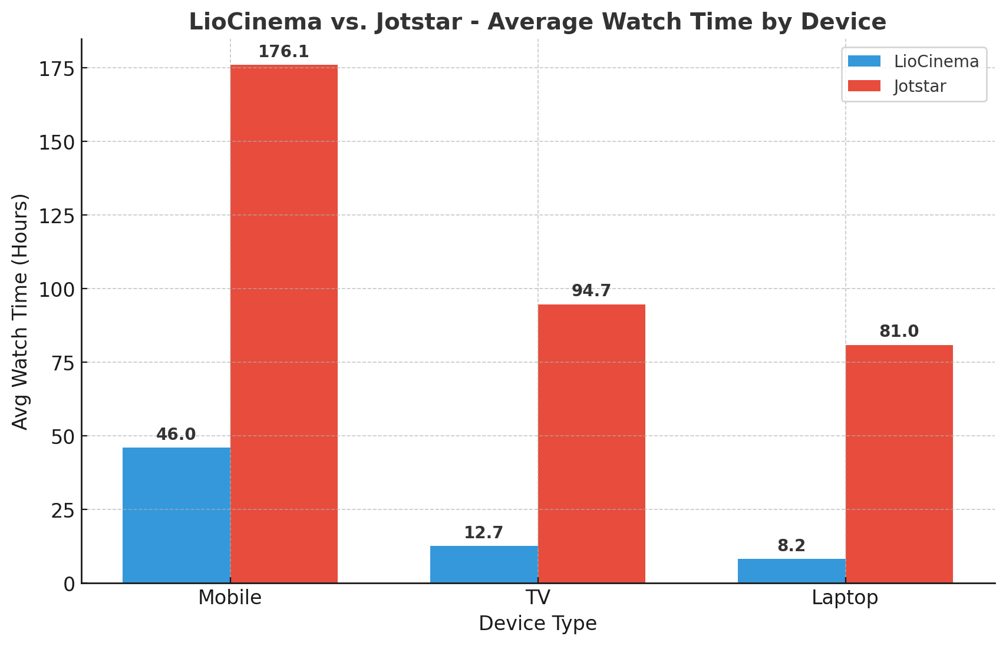
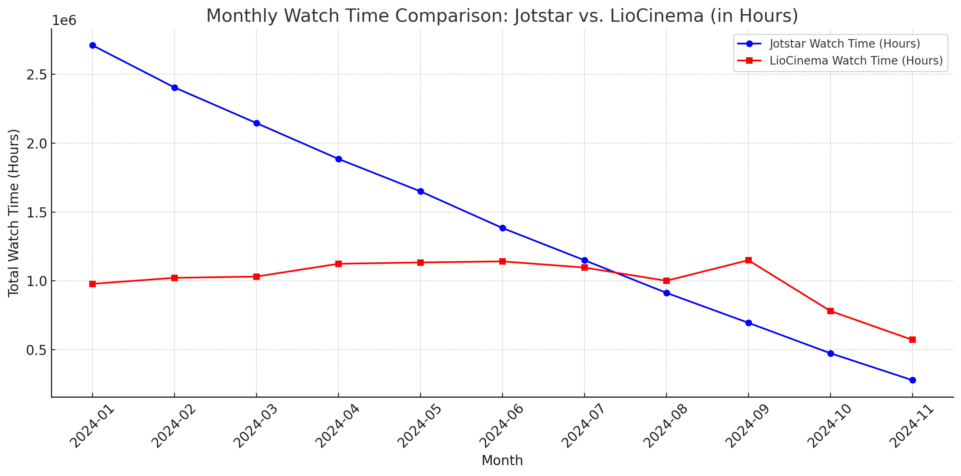
5. Watch Time Analysis
What is the average watch time for LioCinema vs. Jotstar during the analysis period? How do these compare by city tier and device type?
Jotstar
LioCinema
📊 Insights (Jotstar vs. LioCinema Watch Time):
Jotstar Leads:
Jotstar consistently has higher watch time than LioCinema but LioCinema Surpasses in Sep, Oct & Nov.
Declining Trend:
Both platforms show a steady decrease in watch time from January to November 2024.
LioCinema Stability:
LioCinema's watch time remains stable (~1M hours/month) until August, with a spike in September.
Market Implications:
Jotstar dominates but faces faster decline, while LioCinema maintains steady engagement.

Slide 9
📊 Watch Time Comparison – LioCinema vs. Jotstar (Avg. Hours)
City Tier | Platform | Laptop ⌨️ | Mobile 📱 | TV 📺
Tier 1 | LioCinema | 11.58 | 66.94 | 17.93
 | Jotstar | 92.56 | 192.86 | 108.77
Tier 2 | LioCinema | 8.44 | 51.45 | 13.01
 | Jotstar | 70.58 | 161.85 | 82.59
Tier 3 | LioCinema | 5.63 | 30.76 | 8.43
 | Jotstar | 53.80 | 134.85 | 60.77
🔍 Key Insights:
📱 Mobile dominates across both platforms, but Jotstar's mobile watch time is ~3x higher than LioCinema across all tiers.
⌨️ Laptop usage is significantly lower for LioCinema, while Jotstar shows higher engagement, especially in Tier 1 (92.56 hours).
📺 TV watch time is much higher on Jotstar (e.g., 108.77 hours in Tier 1) compared to LioCinema (only 17.93 hours).
📉 LioCinema has significantly lower watch time across all devices and tiers, indicating either a smaller user base or lower engagement per user.

Slide 10
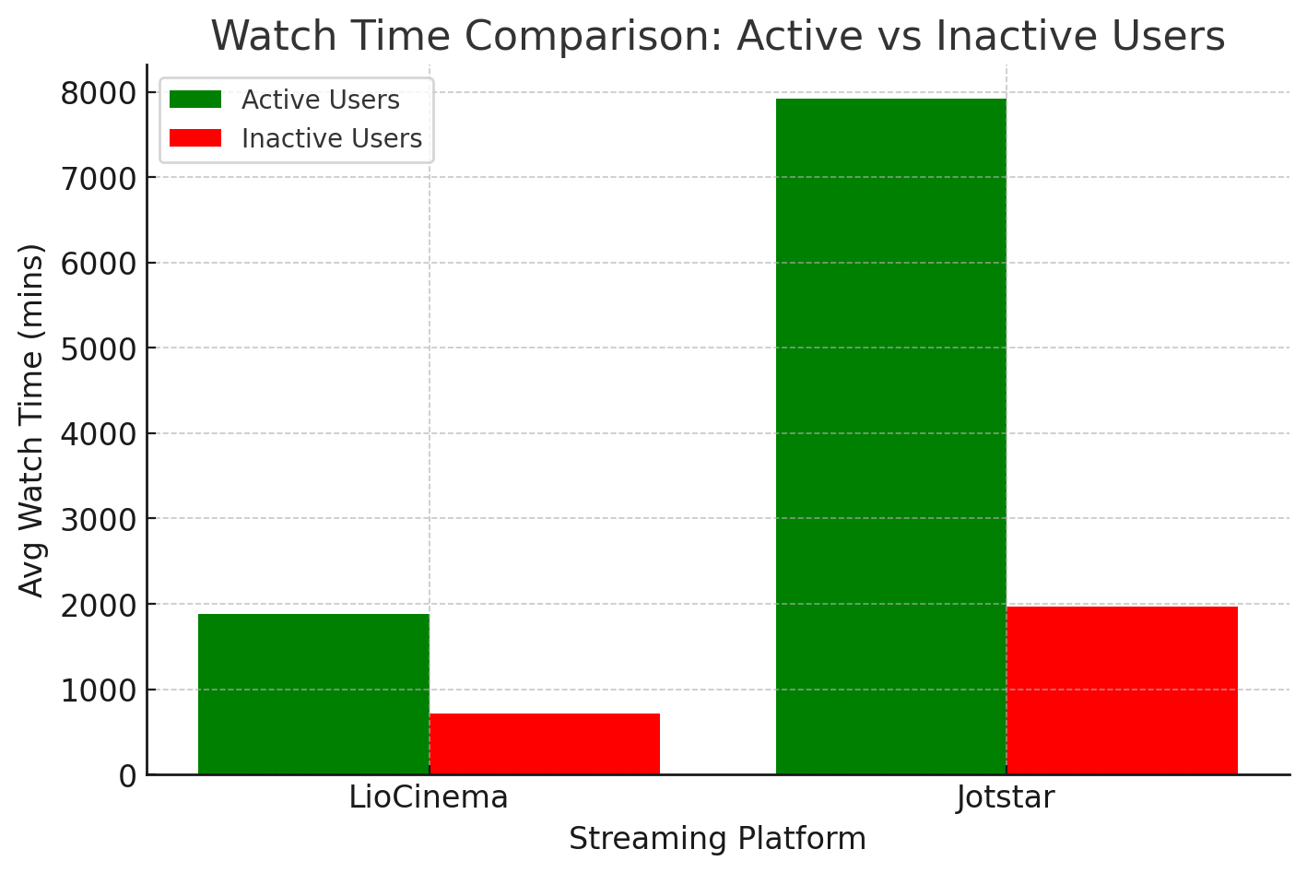
6. Inactivity Correlation
How do inactivity patterns correlate with total watch time or average watch time? Are less engaged users more likely to become inactive?
Correlation with Watch Time:
Active users on both platforms have significantly higher average watch time compared to inactive users.
For LioCinema, active users watch around 1880.72 minutes, while inactive users watch only 717.34 minutes.
For Jotstar, active users watch 7921.65 minutes, whereas inactive users watch only 1970.94 minutes.
Engagement & Inactivity:
Users with lower watch time tend to become inactive.
The trend is more pronounced in Jotstar, where active users watch nearly 4x more than inactive users, suggesting stronger engagement retention.
Overall, lower engagement (watch time) increases the likelihood of inactivity, indicating a potential need for engagement strategies like personalized recommendations or loyalty programs to retain users

Slide 11
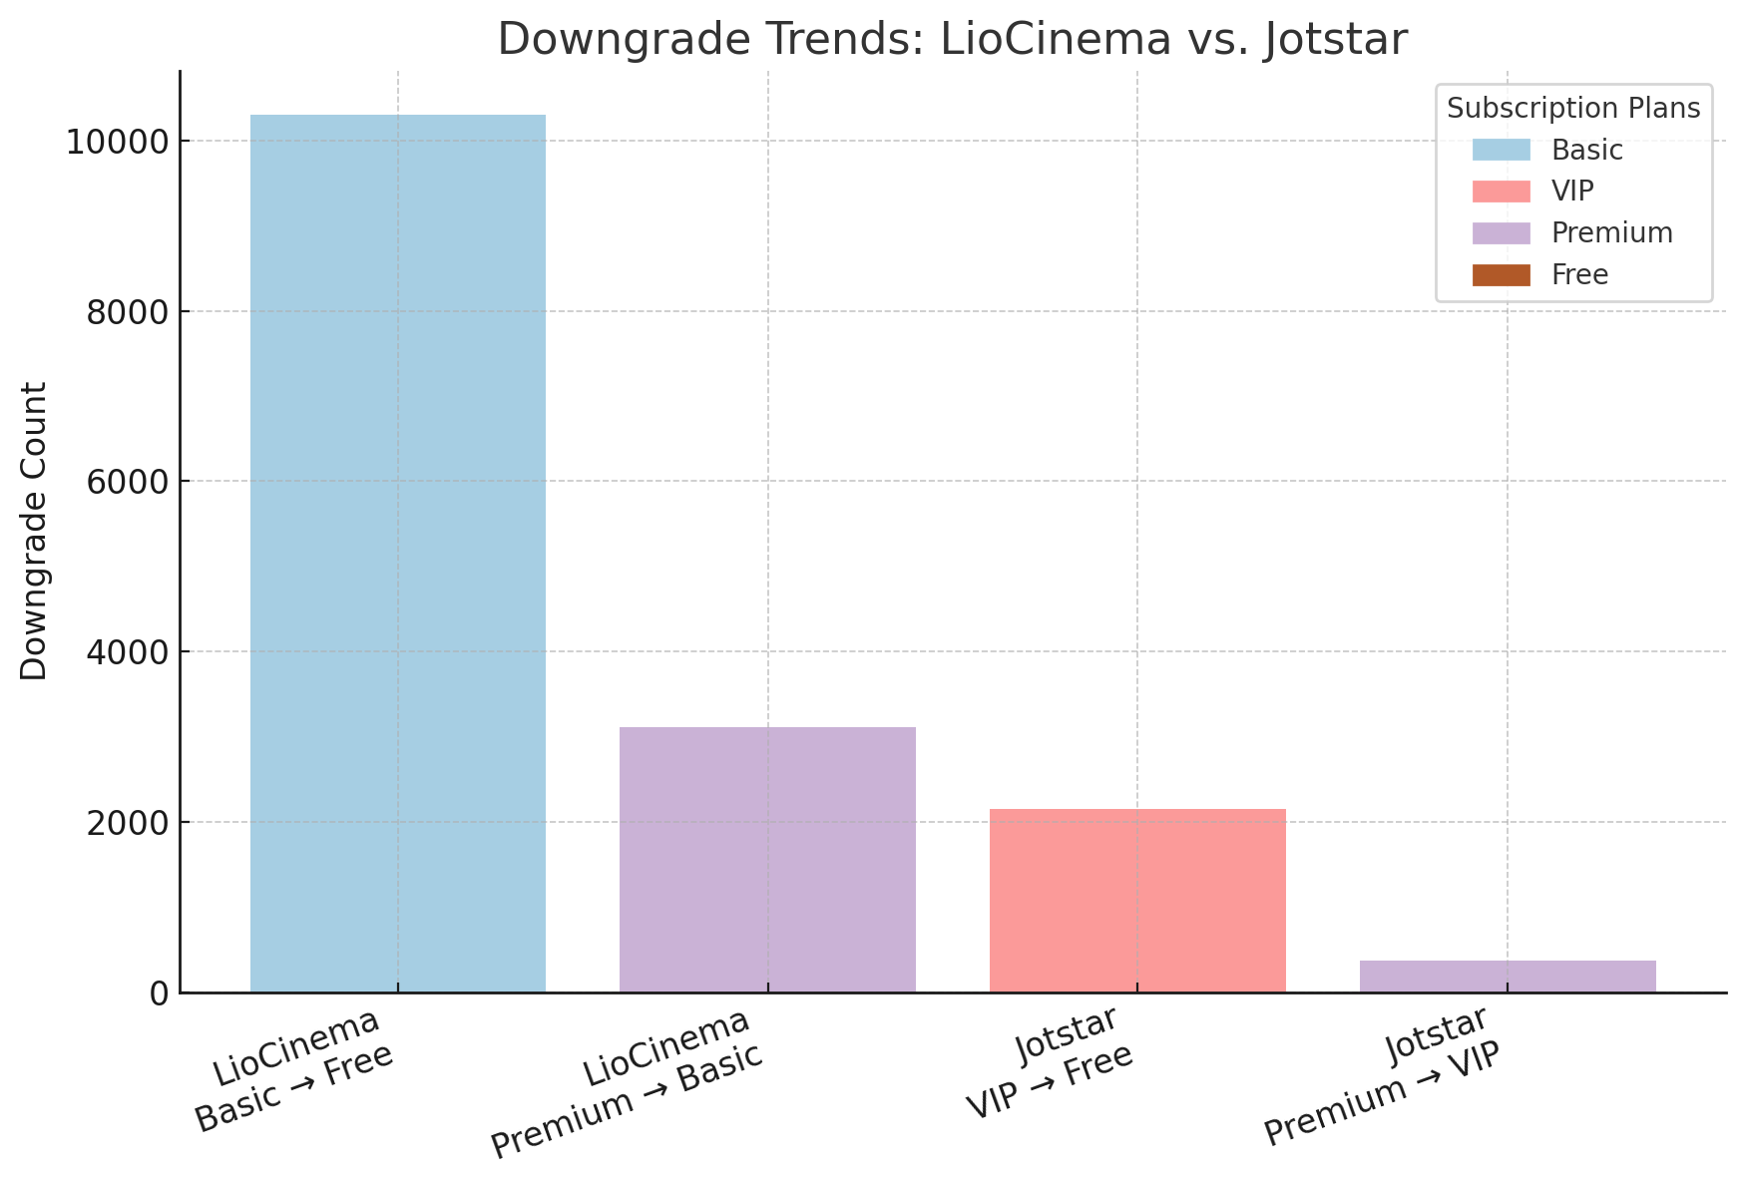
7. Downgrade Trends
How do downgrade trends differ between LioCinema and Jotstar? Are downgrades more prevalent on one platform compared to the other?
Jotstar
Previous_plan | Downgraded_to | downgrade_count
'VIP’ | 'Free’ | '2149'
'Premium’ | 'VIP’ | '368'
Liocinema
Previous_plan | Downgraded_to | downgrade_count
'Basic’ | 'Free’ | '10309'
'Premium’ | 'Basic’ | '3111'
Downgrade Trends Summary
LioCinema has a much higher downgrade rate than Jotstar.
10,309 users downgraded from Basic to Free on LioCinema vs. 2,149 users from VIP to Free on Jotstar.
Total downgrades: LioCinema (13,420) vs. Jotstar (2,517).
LioCinema’s Basic plan sees the most downgrades, indicating lower user retention.
Possible reasons: lower perceived value, content quality, or pricing issues.
Jotstar retains more users in paid tiers, showing better engagement.
➡ LioCinema needs to improve content and user experience to reduce downgrades.

Slide 12
8. Upgrade Patterns
What are the most common upgrade transitions (e.g., Free to Basic, Free to VIP, Free to Premium) for LioCinema and Jotstar? How do these differ across platforms?
Jotstar - Upgrade Transitions
LioCinema - Upgrade Transitions
Previous Plan | Upgraded To | Upgrade Count
VIP | Premium | 2,821
VIP | Free | 2,149
Free | VIP | 844
Free | Premium | 683
Premium | VIP | 368
Premium | Free | 225
Previous Plan | Upgraded To | Upgrade Count
Basic | Free | 10,309
Premium | Free | 7,439
Premium | Basic | 3,111
Free | Basic | 2,078
Basic | Premium | 1,362
Free | Premium | 715
Upgrade Patterns Analysis.
LioCinema sees the highest transitions from Basic to Free (10,309) and Premium to Free (7,439), suggesting many users drop to the free tier.
Jotstar has significant upgrades from VIP to Premium (2,821) and VIP to Free (2,149), indicating VIP users either upgrade or drop off.
LioCinema has more downgrade-like movements, while Jotstar has a more balanced mix of upgrades and downgrades.

Slide 13
9. Paid Users Distribution
How does the paid user percentage (e.g., Basic, Premium for LioCinema; VIP, Premium for Jotstar) vary across different platforms? Analyze the proportion of premium users in Tier 1, Tier 2, and Tier 3 cities and identify any notable trends or differences.
Jotstar - Paid Users Distribution
City Tier | Paid Users | Total Users | Paid User Percentage (%)
Tier 1 | 20,340 | 25,451 | 79.92%
Tier 2 | 9,360 | 13,424 | 69.73%
Tier 3 | 2,824 | 5,745 | 49.16%
LioCinema - Paid Users Distribution
City Tier | Paid Users | Total Users | Paid User Percentage (%)
Tier 1 | 22,599 | 41,011 | 55.10%
Tier 2 | 31,660 | 63,848 | 49.59%
Tier 3 | 24,195 | 78,587 | 30.79%

Slide 14
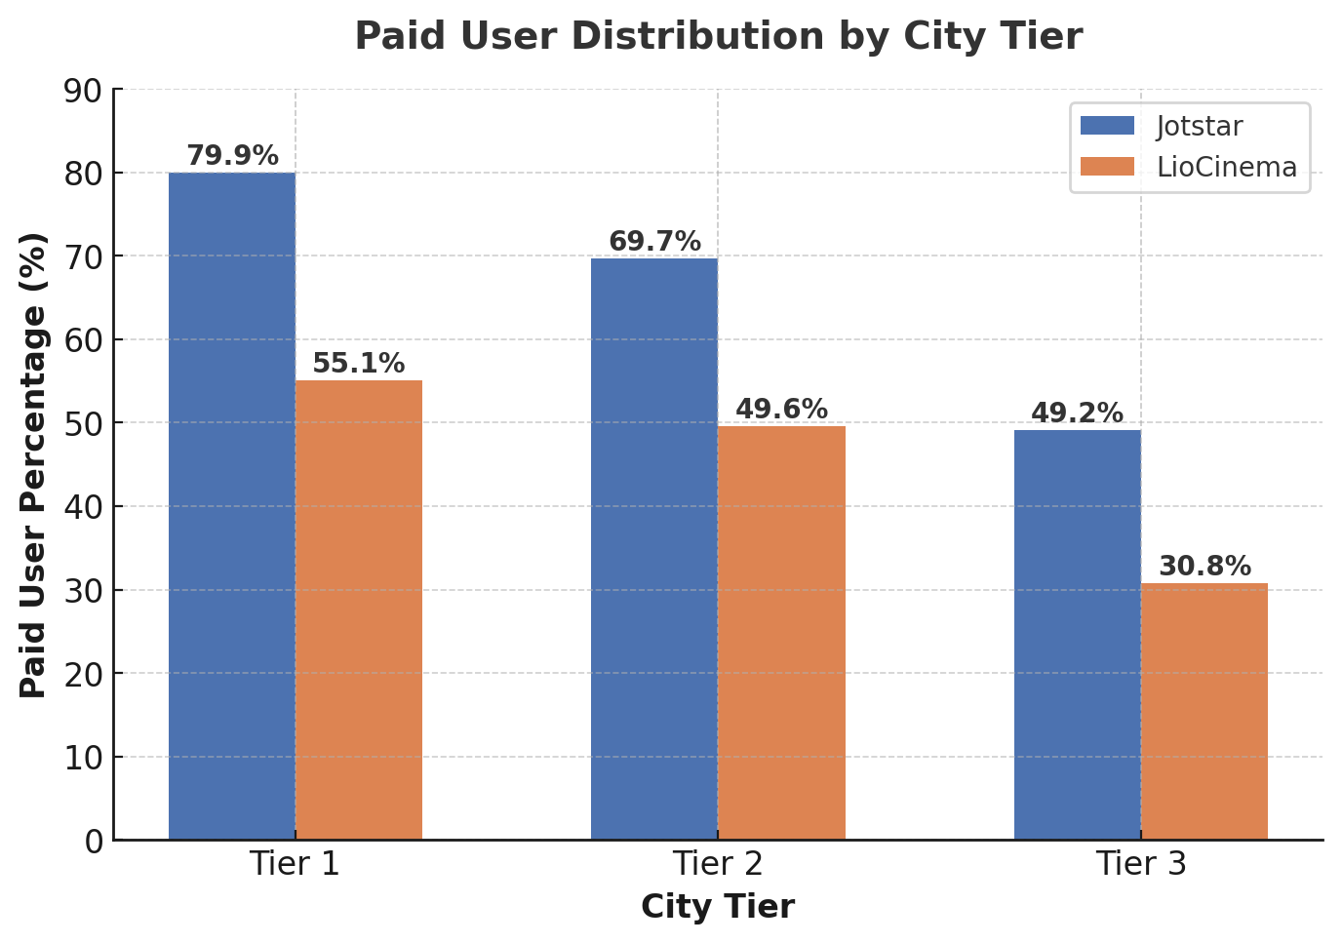
Paid Users Distribution Analysis
Jotstar has a higher paid user percentage in all city tiers compared to LioCinema.
Tier 1 cities show the highest proportion of premium users on both platforms (Jotstar: 79.9%, LioCinema: 55.1%).
Tier 3 cities have the lowest paid user percentage (Jotstar: 49.1%, LioCinema: 30.8%), indicating affordability challenges or preference for free content.
LioCinema has a more balanced distribution across tiers, while Jotstar has a stronger premium user base.

Slide 15
10. Revenue Analysis
Assume the following monthly subscription prices, calculate the total revenue
generated by both platforms (LioCinema and Jotstar) for the analysis period (January
to November 2024).
The calculation should consider:
❖ Subscribers count under each plan.
❖ Active duration of subscribers on their respective plans.
❖ Upgrades and downgrades during the period, ensuring revenue reflects the time spent under each plan.
Platform | Plan | Plan Price
LioCinema | Basic | ₹69
 | Premium | ₹129
Jotstar | VIP | ₹159
 | Premium | ₹359
Final Revenue Analysis for LioCinema & Jotstar (Jan - Nov 2024)
Platform | Subscription Plan | Subscribers | Plan Price (₹) | Months Active | Total Revenue (₹)
LioCinema | Basic | 53,362 | 69 | 149,718 | 10,330,542 (10.33M)
 | Premium | 25,092 | 129 | 54,541 | 7,035,789 (7.0M)
Jotstar | VIP | 19,157 | 159 | 78,439 | 12,471,801 (12.4M)
 | Premium | 13,367 | 359 | 63,901 | 22,940,459 (22.94M)
Insights from Revenue Analysis
🔹 Jotstar's Premium plan generated the highest revenue (₹22.94M), despite fewer subscribers than LioCinema's Basic plan. 🔹 LioCinema’s Basic plan has the highest subscriber count but generates lower revenue due to its low price point. 🔹 Jotstar’s VIP plan has a longer average active duration than Premium, contributing to higher total revenue. 🔹 LioCinema’s Premium users have a shorter active duration compared to Basic users, affecting overall revenue.

Slide 16
Bonus Findings

Slide 17
Watch Time Analysis Results
Jotstar:
Total Watch Time = 941,639,419 minutes
Average Watch Time = 7,034.51 minutes (~117 hours)
LioCinema:
Total Watch Time = 661,992,388 minutes
Average Watch Time = 1,536.83 minutes (~26 hours)

Slide 18
Watch Time Insights by Device & City Tier
1️⃣ Watch Time by Device Type
Device Type | Jotstar - Total Watch Time | Jotstar - Avg Watch Time | LioCinema - Total Watch Time | LioCinema - Avg Watch Time
📱 Mobile | 471,349,854 mins | 10,563.65 mins (~176 hrs) | 506,869,771 mins | 2,763.05 mins (~46 hrs)
📺 TV | 253,558,606 mins | 5,682.62 mins (~95 hrs) | 93,888,280 mins | 759.28 mins (~12 hrs)
💻 Laptop | 216,730,959 mins | 4,857.26 mins (~81 hrs) | 61,234,337 mins | 495.21 mins (~8 hrs)
1️⃣ Watch Time by City Tier
City Tier | Jotstar - Total Watch Time | Jotstar - Avg Watch Time | LioCinema - Total Watch Time | LioCinema - Avg Watch Time
Tier 1 | 601,940,570 mins | 7,883.65 mins (~131 hrs) | 221,522,138 mins | 2,106.14 mins (~35 hrs)
Tier 2 | 253,727,162 mins | 6,300.33 mins (~105 hrs) | 258,297,683 mins | 1,624.77 mins (~27 hrs)
Tier 3 | 85,971,687 mins | 4,988.20 mins (~83 hrs) | 182,172,567 mins | 1,093.47 mins (~18 hrs)
🔹 Key Insights:
Mobile has the highest watch time on both platforms.
TV users on Jotstar watch much more compared to LioCinema.
Laptop usage is lower on LioCinema compared to Jotstar.
Tier 1 users have the highest watch time on both platforms.
Tier 2 watch time is almost equal between both platforms.
Tier 3 users on Jotstar are less engaged compared to LioCinema.

Slide 19
📊 User Growth Analysis (Jan–Nov 2024)
Jotstar(Slower Growth)
Consistent but slow increase in new subscribers each month.
Growth from 3,934 (Jan) → 4,262 (Nov) (+8.3%).
LioCinema(Faster Growth)
Rapid acceleration in new subscribers.
Growth from 6,758 (Jan) → 36,997 (Nov) (+447%).
🚀 Key Insights:
LioCinema is growing significantly faster than Jotstar.
Jotstar’s growth is stable but limited—possible reasons: lower marketing efforts, fewer promotions, or less engaging content.
LioCinema's aggressive growth may be driven by strong campaigns, exclusive content, or partnerships.

Slide 20


After analysis…
Final Recommendations
What strategies can the merged platform implement to increase engagement among inactive users and convert them into active users?
Key Observations
Inactive users have an average watch time of 2,463 minutes and total watch time of 7,031 minutes per user—indicating low engagement.
Higher inactivity rates correlate with lower total watch time.
Actionable Strategies
AI-Powered Personalization – Recommend content based on past behavior, with push notifications & emails.
Flexible Subscriptions – Offer trials, pay-per-view, and pause instead of cancel.
Gamification & Rewards – Introduce loyalty points, badges, and streak-based incentives.
Targeted Marketing – “We Miss You” discounts, retargeting ads, and personalized outreach.
Enhanced UX & Community Features – Watch parties, live Q&As, and exclusive content.
Multi-Device Optimization – Improve low-end device experience & enable offline downloads.
Proactive Support & Feedback – Quick chatbot/human support, plus exit surveys.
🚀 Outcome: Higher retention, increased engagement, and improved user satisfaction.

Slide 21
What type of brand campaigns should the merged platform launch to establish itself as the go-to OTT platform in India?
Brand Campaigns for the Merged OTT Platform in India
To establish dominance in India's OTT market, the platform should launch high-impact, culturally relevant, and engagement-driven campaigns.
1. Grand Launch & Awareness – "India Ka Apna OTT"
✅ Nationwide TV, digital, and outdoor ads featuring Bollywood & regional stars. ✅ Leverage IPL & cricket events for massive reach.
2. Regional & Cultural Connect – "Meri Bhasha, Mera OTT"
✅ Promote multi-language content with regional celebrities. ✅ Organize exclusive regional film festivals.
3. Value & Affordability – "Premium Entertainment, Budget Price"
✅ Highlight lower subscription costs than competitors. ✅ Partner with Jio, Airtel, Vi for bundled offers & free trials.
4. Social & Digital Virality – "Watch, Share & Win"
✅ Run UGC challenges, trending memes, and influencer collabs. ✅ Engage Gen Z & millennials via Instagram, YouTube, and Twitter.
5. Exclusive Content Drive – "Stories That Stay With You"
✅ Market original series, blockbuster premieres & behind-the-scenes content. ✅ Launch “Viewer’s Choice” polls for content selection.
6. Family & Kids-Focused – "Entertainment for Everyone"
✅ Promote safe kids’ content with parental controls. ✅ Partner with schools & ed-tech platforms for branded content.
🚀 Result: Increased brand recall, user acquisition, and long-term retention.

Slide 22
How should the merged platform price its subscription plans to compete effectively while maintaining profitability?
📌 Suggested Subscription Plans
Plan | Target Audience | Features | Price (₹/month) | Price (₹/year)
Free (Ad-Supported) | Budget users | Limited library, ads | ₹0 | ₹0
Basic | Individual users, students | 720p, 1 screen | ₹69 – ₹99 | ₹799
Standard | Families, regional users | 1080p, 2 screens, ad-free | ₹149 – ₹179 | ₹1,599
Premium | Binge-watchers, movie lovers | 4K, 4 screens, ad-free, exclusive shows | ₹299 – ₹349 | ₹3,299
VIP (Bundled with Telcos) | Jio, Airtel, Vi users | Premium content via telecom partnerships | ₹99 (via telecom) | ₹999
✅ Why this works?
Competitive vs. Netflix (₹199-649) & Prime Video (₹299).
Free tier boosts user acquisition, upsells to paid plans.
Telecom partnerships expand reach & revenue.
📌 Additional Monetization
Regional & Student Discounts – Lower rates in Tier 2 & 3 cities, 30-40% off for students.
Ad-Supported Tier – Revenue via interactive & skippable ads.
Pay-Per-View – Premium movies at ₹99-₹299 per rental.
Sports Add-Ons – Live cricket/IPL streaming at ₹49-₹99 per event.
🚀 Final Takeaway: A balanced model with a free tier, affordable plans, and multiple revenue streams ensures market leadership & profitability.

Slide 23
How can the platform leverage partnerships with telecom companies to expand its
subscriber base?
Leveraging Telecom Partnerships for Rapid Growth
🚀 Telecom tie-ups can drive massive OTT adoption, boost engagement & maximize conversions.
1️⃣ Bundled OTT + Mobile Data Plans 📶
Free trials or discounted subscriptions with Lio, Mirtel, Ui recharges.
High-tier plans (₹599+) include Premium OTT access (e.g., LioFiber + Jotstar).
2️⃣ Exclusive Co-Branded OTT Packs 🎟️
Mobile-Only Plans – ₹99/month via Ui & Mirtel for budget users.
3️⃣ Preloaded OTT App on Devices 📱📺
Smartphones – Pre-installed app on LioPhone, Ui handsets (3-month free access).
Smart TVs & ISPs – Free Premium OTT with broadband connections.
4️⃣ Direct Telecom Promotions 📢
Push Notifications & SMS – Instant activation via telco messages.
Data Boost Offers – Extra 2GB/day for seamless OTT streaming.
5️⃣ Carrier Billing & Pay-Per-View 💳
Easy Payments – Rent movies, live sports via mobile balance/postpaid bill.
Exclusive IPL/PPV Deals – ₹199 live match access via Jio Pay.
📌 Final Takeaway: Strategic telecom alliances will skyrocket subscribers, boost engagement & drive revenue for both the OTT platform & telcos.
Logo & Name
Liojotstar

Slide 24

What role can AI and machine learning play in personalizing the user experience and
improving content discovery?
AI & Machine Learning: Transforming OTT Personalization
🚀 AI & ML enhance content discovery, user experience, and engagement on OTT platforms.
1️⃣ AI-Powered Content Recommendations 🎯
Personalized Watchlists – AI suggests content based on viewing history.
Mood-Based Picks – ML detects emotions & recommends fitting content.
Smart Genre Tagging – AI curates recommendations by themes & actors.
2️⃣ Hyper-Personalized UI & Experience 🖥️
Dynamic Homepage – Rearranges content based on preferences.
Auto-Resume & Shortcuts – AI remembers unfinished shows.
Adaptive Streaming – Adjusts video quality for seamless playback.
3️⃣ AI-Driven Voice & Chat Assistance 🎙️
Voice Search – Find content via voice commands.
Smart Previews – AI generates quick content highlights.
4️⃣ AI for Monetization & Ads 💰
Targeted Ads – ML ensures relevant, non-intrusive ads.
Pay-Per-View Suggestions – Personalized premium content recommendations.
5️⃣ AI in Content Moderation & Accessibility 🔍
AI Subtitles & Dubbing – Real-time multilingual support.
Parental Controls – AI filters content for safe family viewing.
📌 Final Takeaway: AI & ML will boost engagement, enhance discovery & drive retention for OTT platforms.

Slide 25






Who should be the brand ambassador for the newly merged OTT platform (LioCinema-Jotstar) to effectively represent its identity and attract a diverse audience?
Best Brand Ambassador for LioCinema-Jotstar 🎬🔥
To maximize reach & engagement, the ambassador must have:
Mass Appeal – Pan-India influence across all demographics
OTT Presence – Strong connection with digital audiences
Youth & Family Connect – Popular among Gen Z, millennials & families
🚀 Top Picks: 1️⃣ Shah Rukh Khan (The Evergreen Icon) 🌟 – Global superstar, premium brand image 2️⃣ Allu Arjun (South + National Sensation) 🔥 – Pan-India appeal post Pushpa 3️⃣ Pankaj Tripathi (The OTT King) 🎭 – Trusted face of web content 4️⃣ Rashmika Mandanna/Kiara Advani (Youth & Family Favorite) 💃 – Connects with millennials & Gen Z 5️⃣ Virat Kohli (Cricket + Entertainment) 🏏🎬 – Engages sports & OTT audience
🎯 Final Choice: 🔹 Single Ambassador: Shah Rukh Khan for maximum impact 🔹 Multi-Ambassador Strategy: Allu Arjun + Pankaj Tripathi + Rashmika Mandanna for diverse audience reach

Slide 26
Thanks To Codebasics.io

